Slide 1
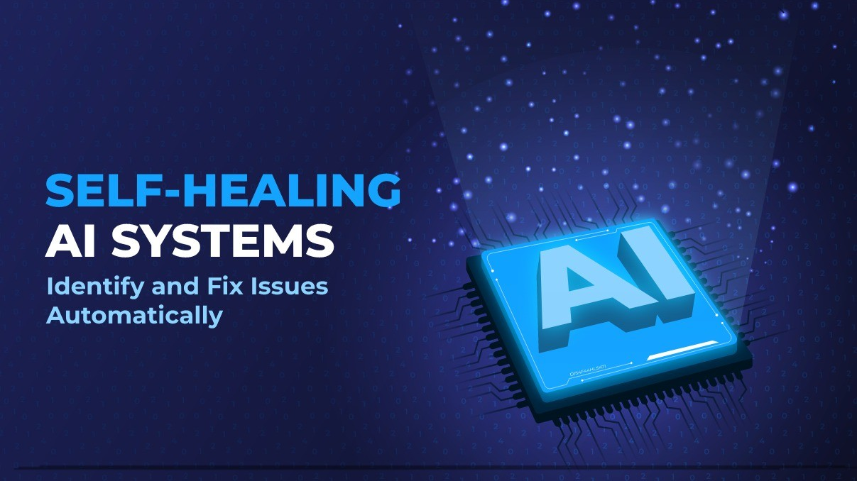
AutoHealAI: Intelligent Multi-Agent Platform
Syed Abjimiah
&
Amit Kumar Yadav

Slide 2
What is Self-Healing?
Self-Healing is an intelligent capability that enables a software system to automatically detect failures, identify the root cause, recover from the issue, and verify that the service is healthy again—without requiring manual intervention.
Instead of waiting for an engineer to investigate production issues, AI agents continuously monitor the application, analyse logs, perform recovery actions, validate the results, and restore normal operations automatically.
Why Self-Healing?
Traditional applications rely heavily on manual monitoring and troubleshooting, which increases downtime and impacts user experience.
AutoHealAI minimizes service disruption by providing:
Automatic Failure Detection
Intelligent Root Cause Analysis
Automated Recovery Actions
Continuous Health Verification
Reduced Mean Time To Recovery (MTTR)
Improved System Reliability and Availability

Slide 3
Project Overview (PRD)
Project Type: Intelligent Multi-Agent Platform for Weather API Monitoring & Automated Recovery.
Domain : Weather API Monitoring
Project Description:
AutoHealAI is an AI-powered multi-agent platform designed to continuously monitor Weather APIs, detect service failures, diagnose the underlying causes, automatically perform recovery actions, verify system health, and restore services with minimal downtime.
The system combines autonomous AI agents, GraphRAG, observability, and automated healing workflows to ensure high availability and reliable weather information for end users.
Scope
• Real-Time Weather API Monitoring
• Intelligent Incident Detection
• AI-Based Root Cause Analysis
• Automatic Service Recovery
• Validation & Health Checks
• Continuous Learning

Slide 4
Problem Statement: 1
Existing System (Without Self-Healing)
Example 1 — Weather API Downtime
Scenario
A user requests:
"What is the weather in Chennai today?“
The Weather API server unexpectedly crashes.
Result:
❌ API returns HTTP 503 Service Unavailable
❌ User receives an error message
❌ Support team receives alerts
❌ Engineers manually inspect logs
❌ container is restarted manually
❌ Users wait several minutes
With AutoHealAI (Self-Healing)
Example 1
User asks:
"What is the weather in Chennai today?"
Workflow:
User Request
Monitoring Agent detects HTTP 503
Diagnosis Agent analyzes logs
Root Cause Agent identifies stopped Docker container
Healing Agent restarts Weather API
Validation Agent confirms API health
Weather information is returned successfully
Result:
✅ User receives weather information
✅ Recovery completed automatically
✅ No manual intervention required

Slide 5
Problem Statement: 2
Without Self-Healing
Example 2 — Slow Weather API Response
A user searches:
"Weather forecast for Bangalore.“
The API experiences high latency because of increased traffic.
Result:
❌ Response takes 40 seconds
❌ Request eventually times out
❌ User refreshes repeatedly
❌ Customer experience is degraded
❌ Engineers investigate after complaints
With AutoHealAI (Self-Healing)
Example 2
User asks:
"Weather forecast for Bangalore“
Workflow:
Monitoring Agent detects slow response
Diagnosis Agent identifies high CPU utilization
Healing Agent scales service or clears overloaded processes
Validation Agent performs health check
API response time returns to normal
Result
✅ Fast response restored
✅ No service interruption

Slide 6
Project Goals
Goal 1
Continuous Monitoring
Monitor Weather APIs 24×7 to detect failures, slow responses, and abnormal behavior in real time.
Goal 2
Intelligent Diagnosis
Analyze application logs, metrics, and health data to determine the actual root cause of incidents.
Goal 3
Automated Recovery
Execute predefined healing actions such as restarting services or recovering failed containers automatically.
Goal 4
Health Verification
Validate that the Weather API is functioning correctly after recovery before serving users.
Goal 5
Continuous Learning
Capture incident history and successful recovery patterns to improve future decision-making.
Goal 6
Operational Excellence
Reduce downtime, minimize manual effort, and improve overall service reliability.

Slide 7
Project Features
Key Features
Interactive Streamlit Chat Interface LangSmith Observability & Monitoring
Weather API Integration Audit Logging & Middleware
Real-Time Health Monitoring Agent Docker-Based Deployment
AI-Based Diagnosis Agent
Root Cause Analysis Agent
Automated Healing Agent
Recovery Validation Agent
Learning Agent for Knowledge Retention
GraphRAG Knowledge Base (Neo4j + FAISS)

Slide 8
Weather API Self-Healing- Architecture Diagram
User Layer
API & Service Layer
Middleware Layer
Graudrails Layer
Agents Layer
Knowledge Layer
Observability Layer
Streamlit UI
Chat Interface
Weather API
GraphRAG Engine
AI Agent Orchestration Layer
(LangGraph Supervisor)
Neo4j (GraphDB) + FAISS(VectorDB)
Fast API
Rest API Endpoints
Monitoring
Agent
LLM
Diagnosis
Agent
Langsmith
Traces
Metrics
Evaluation
Dashboards
Logging
Monitoring
Audit Trail
Error Handling
Root Cause
Agent
Middleware
Healing
Agent
Validation
Agent
Guardrails Layer
(Ensure safe, valid & reliable operations)
Learning
Agent
Deployment Layer
Docker
Input Validation & Sanitization
PII Detection & Protection
Hallucination & Policy Check

Slide 9
Agents WorkFlow - Diagram
Failure
(Down/Slow/Error)
1.Monitoring
(Detect Failures)
2. Diagnosis
(Analyse logs, metrics &alerts)
3. Healing
(Perform recovery actions – Restart, scale, fix)
4. Validation
(Health Check)
Weather API
Request
Weather API
Recovery Success?
Return output to User
Retry
(Max Retry Count)
No
Yes

Slide 10
End-to-End Workflow
User
│
▼
Streamlit Chat Interface
│
▼
User enters weather query
"Weather in Chennai"
│
▼
FastAPI Receives Request
│
▼
Middleware Processing
• Logging
• Monitoring
• Audit Trail
• Error Handling
│
▼
Guardrails Validation
• Input Validation
• PII Detection
• Policy Check
│
▼
Request sent to Weather API
Weather API Failure
(503 / Timeout / Slow API)
│
▼
Monitoring Agent Detects Issue
│
▼
Diagnosis Agent Analyses Logs
│
▼
Root Cause Agent Identifies Problem
│ ▼ Healing Agent Executes Recovery • Restart Weather API • Retry Request • Clear Cache • Restart Container
Validation Agent Performs Health Check │ ▼ Recovery Successful? ┌───────┴────────┐ │ │ YES NO │ │ ▼ ▼ Learning Agent Retry Recovery Stores Incident (Max Retry) Knowledge │ │ │ └──────────┬──────┘ ▼ Recovery Successful? │ ┌────┴────┐ │ YES NO │ │ ▼ ▼ Return Weather Send Alert to Response User Support Team

Slide 11
Failure Scenarios
Failure | Detection | Healing
HTTP 503 | Monitoring Agent | Restart Service
API Timeout | Monitoring Agent | Retry Request
HTTP 429 | Diagnosis Agent | Backoff & Retry
DNS Failure | Root Cause Agent | Reconnect Network
Invalid JSON | Validation Agent | Retry API
Docker Crash | Healing Agent | Restart Container
High CPU | Monitoring Agent | Scale Container
Memory Leak | Diagnosis Agent | Restart Process

Slide 12
Business Benefits
80–90% reduction in manual intervention
Lower Mean Time to Recovery (MTTR)
Higher API availability
Improved customer experience
Faster incident resolution
Reduced operational costs
24×7 automated monitoring
Scalable and production-ready architecture
Future Enhancements
Examples:
Kubernetes auto-scaling
Multi-cloud deployment
Support for multiple Weather APIs
Predictive failure detection
Grafana dashboard integration
Voice-enabled AI assistant

Slide 13
Conclusion
AutoHealAI demonstrates how autonomous AI agents can transform traditional API monitoring into an intelligent self-healing platform.
By combining continuous monitoring, AI-driven diagnosis, automated recovery, and health validation, the platform significantly reduces downtime and operational effort while improving service reliability.
The modular architecture based on LangGraph, GraphRAG, LangSmith, and Docker enables scalable deployment and can be extended to monitor domains beyond Weather APIs, making it suitable for enterprise production environments.

